Slide 1

Bright Path
E-learning Platform
Personalized Education Without Geographic Boundaries
Students: Dumitrof D.S., Ion C.G., Stavarache M.C.
Professor: Conf. Dr. Ing. Costin-Andrei Boiangiu

Slide 2



MISSION: EDUCATION EQUITY
The Challenge
The Solution
Geography often dictates the quality of education. Students in rural or low-bandwidth areas lack access to high-tier pedagogical tools, creating a global "Digital Divide."
Localized integration ensures a student in rural Romania accesses the same tools as a pro in Tokyo, tailored to cultural context and national exam standards.

Slide 3



AI-DRIVEN ADAPTIVE ENGINE
Predictive Sequence Modeling
Utilizing LSTM neural networks to process user behavior and construct personalized "forgetting curves" for proactive Spaced Repetition (SRS).
Ebbinghaus Forgetting Curve: Retention (R) relative to time (t) and stability (S).

Slide 4






CORE SUCCESS PILLARS
Pedagogical Efficacy
Resilience
Retention
25% improvement target in mock examination scores for active users.
99.9% uptime with 10-second offline data resolution via Delta-Sync.
Day-30 retention rates above 40% through gamified loops.

Slide 5
PROPRIETARY BINARY-DELTA SYNC
85%
Overcoming Infrastructure Barriers
Traditional apps resync entire data objects. Our protocol identifies only changed bits ("deltas"), allowing seamless learning even on limited mobile data plans in emerging markets.
Data Footprint Reduction
Prioritizes academic progress over cosmetic updates.

Slide 6


GLOBAL REACH & LOCAL IMPACT
Digital Empowerment
From rural Romania to high-intensity hubs in Japan, Bright Path provides academic lifelines tailored to national standards like the Bacalaureat and JLPT.
•
Nigeria: Micro-credentials for gig economy.
•
Romania: Rural university placement parity.
•
Japan: Focus on social standing gamification.

Slide 7
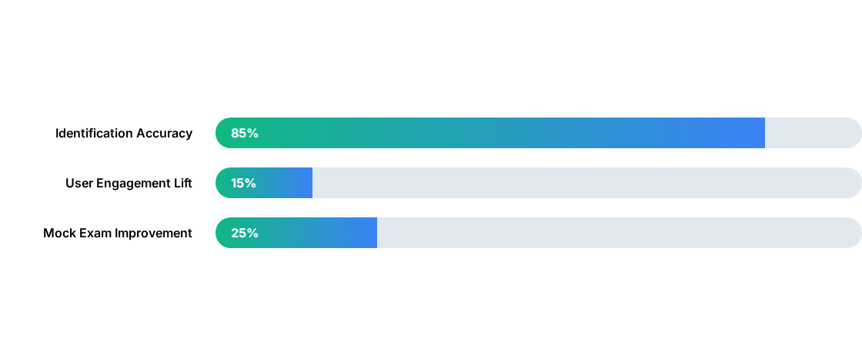
PREDICTIVE LEARNING SUCCESS
Identifying "at-risk" learners before failure using Random Forest regressors and engagement metadata.
*Metrics based on 18-month deployment targets and pilot study data.

Slide 8
STRATEGIC CONSORTIUM STRUCTURE
Work Package | Lead Partner | Primary Responsibility
WP2: Core Dev | Software Enterprise | AI Engine, Backend, and Offline Sync Protocol
WP3: Localization | Regional Universities | Curriculum mapping and multilingual content
WP4: Validation | Educational NGOs | Field testing and User-Acceptance Trials (UAT)
WP5: Impact | Data Scientists | Measuring the "Learning Equity Index" (LEI)

Slide 9
78-WEEK IMPLEMENTATION ROADMAP
Discovery
Core Dev
Localization
Pilot
Launch
Weeks 1–10
Curricular Mapping
Weeks 11–34
AI & Backend
Weeks 35–52
Regional UX
Weeks 53–66
Field Validation
Weeks 67–78
Production Scale

Slide 10

TOTAL BUDGET: €1,250,000
60% Personnel & R&D: €750k
15% Cloud & Computing: €187k
10% Hardware & Pilots: €125k
15% Ops & Contingency: €188k

Slide 11


FUTURE GROWTH & SCALING
Expanding the Horizon
Our roadmap includes a scalable growth model designed to accommodate an initial user base of 50,000, with the elasticity to expand ten-fold within the first two years.
By partnering with global certification bodies, Bright Path transforms skill acquisition into immediate global employability.

Slide 12

Questions & Answers
Thank you for your attention to Bright Path's vision.
Bright Path E-learning Platform
A Multi-Disciplinary Consortium Initiative
www.brightpath-learning.org

Slide 13



IMAGE SOURCES
https://static.vecteezy.com/system/resources/previews/024/812/124/non_2x/deep-learning-visualization-ai-artificial-intelligence-concept-of-neural-networks-wave-equalizer-illustration-vector.jpg
Source: www.vecteezy.com
https://www.gettingsmart.com/wp-content/uploads/2017/02/Diverse-students-using-digital-content-on-their-tablets-in-a-library-Feature-Image.jpg
Source: www.gettingsmart.com
https://jacoblund.com/cdn/shop/files/7e626242bc6f736215943954eee72625_1200x787.jpg?v=1759445611
Source: jacoblund.com

